Slide 1
Ecommerce Product Categorization
Created by -
Balachandru Sellamuthu

Slide 2
Problem Statement
Nowadays, for product purchase and selling, we have a lot of ecommerce sites. It helps us to do the transaction through online and reduce our time with travel and allow us to see all the products across the multiple stores. To help users to see the relevant info we want to categorize the products based on the product description.

Slide 3
About Dataset
Ecommerce dataset has 14999 rows and 15 columns of product_id, product_name, product_url, discount_price, product_rating, product_description, product_category_tree and few more.
Input Feature => description
Output Feature => product_category_tree

Slide 4
Exploratory Data Analysis
Let’s see insights of data. The target product_category_tree has totally 11 distinct values. Those are Clothing, Footwear,Jewellery, Watches, and few more.
We have product description of max length 2000+. It contains alphabets, numbers and lot of special characters. We should remove it before applying the ML model.
The popular product brands details are extracted to see max solded brand.

Slide 5
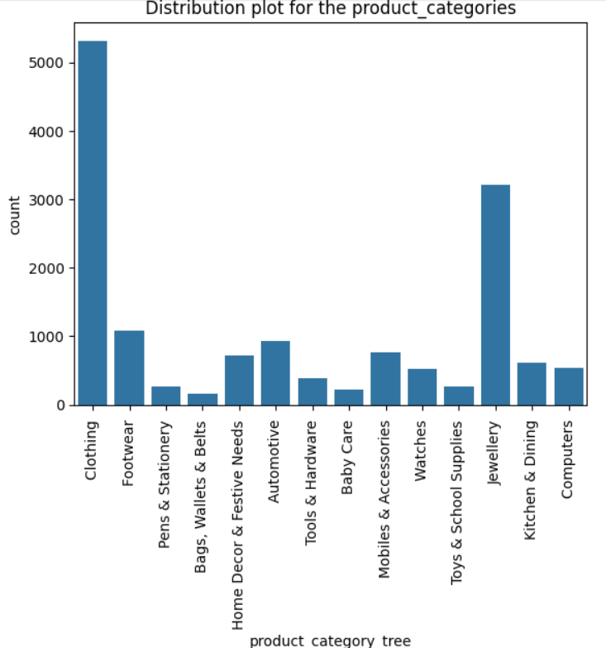
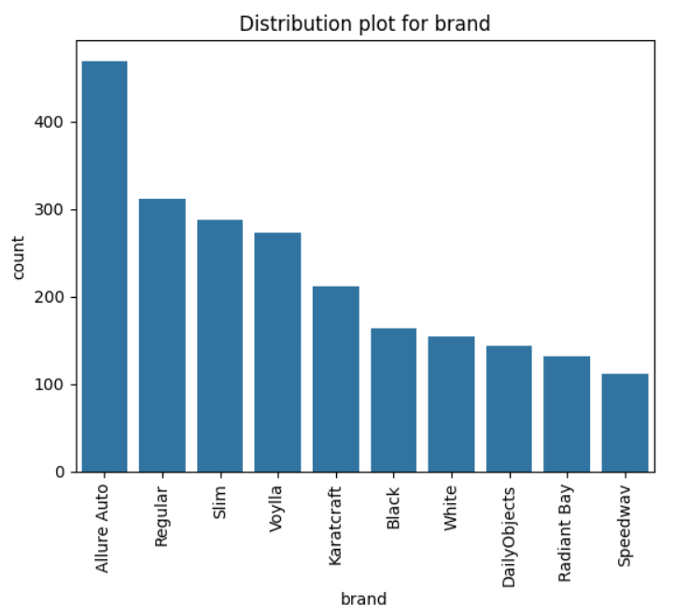
Exploratory Data Analysis

Slide 6
Machine Learning Model
Chosen below algorithms to work with Multi-Class Classification:
Logistic Regression Classifier
Accuracy_score = 84%
F1-Ration = 87%
Support Vector Machine Classifier.
Accuracy_score = 85%
F1-Ration = 88%
Random Forest Classifier (ensemble model).
Accuracy_score = 82%
F1-Ration = 82%
Supervised - Classification

Slide 7
Use cases
Improved product search navigation
Personalized Recommendation
Targeted Advertising
Categorizing products allows users to easily find what they’re looking for by navigating through well-organized categories, such as "Electronics", "Clothing", "Home & Kitchen", etc.
Product categories help in segmenting customers, allowing businesses to send personalized offers, promotions, or recommendations based on the customer’s previous browsing and purchase history.
E-commerce businesses can run targeted advertising campaigns focusing on specific product categories. For instance, a campaign for "Winter Wear" can be tailored around clothing products in that category, reaching the right audience during the right season.

Slide 8
Thank You!
max growth

